Slide 1
COVID-19
COVID Team | Bob Hammond, Estella Moseley, Lawrence Yates, Lori Bruce | MSU Data Analytics

Slide 2
What’s Up In Our County?
The analytics team reviewed data for Kalamazoo, Monroe, Washtenaw and Wayne Counties
Notes:
This is the question that your experiment answers

Slide 3
Project Overview
Explore COVID data related to the four counties that we live in (Monroe, Kalamazoo, Wayne, and Washtenaw), e.g., testing stats, diagnostic results compared to select state statistics, state unemployment related to COVID, etc.

Slide 4
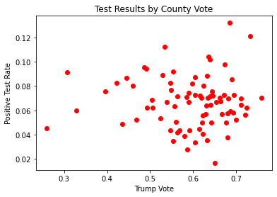
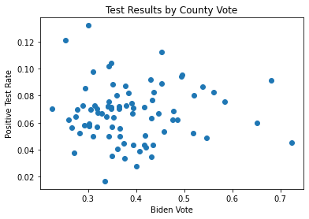
Research – COVID Positive Rate by Vote
Notes:
Summarize your research in three to five points.

Slide 5
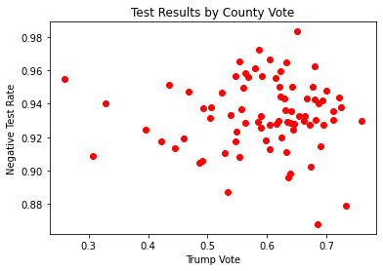
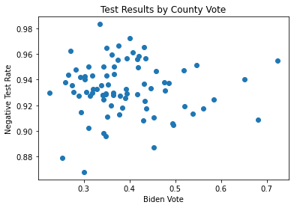
Research – COVID Negative Rate by Vote
Notes:
Summarize your research in three to five points.

Slide 6
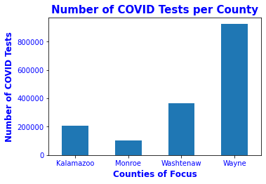
Research – Testing
Notes:
Summarize your research in three to five points.

Slide 7
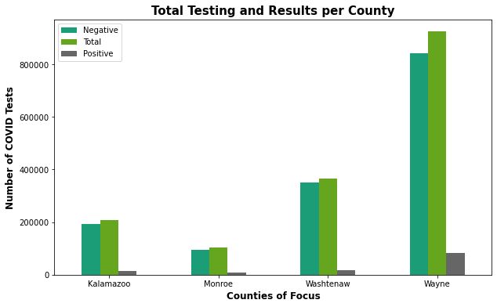
Research – Testing
Notes:
Summarize your research in three to five points.

Slide 8
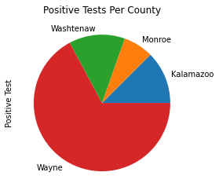
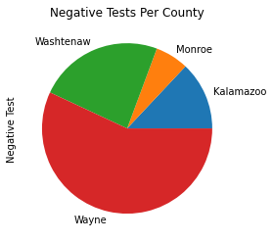
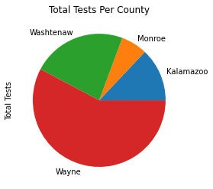
Research – Testing
Notes:
Summarize your research in three to five points.

Slide 9
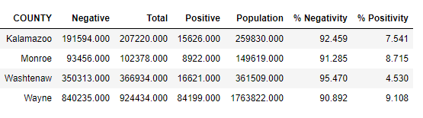
Research – Testing
Notes:
Summarize your research in three to five points.

Slide 10
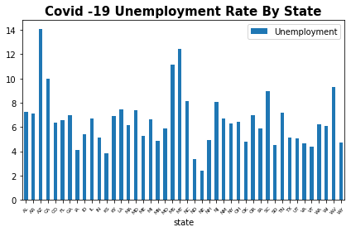
Research – COVID Unemployment Rate
Notes:
Summarize your research in three to five points.

Slide 11
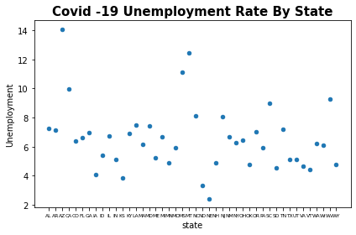
Research – COVID Unemployment Rate
Notes:
Summarize your research in three to five points.

Slide 12
Unemployment Conclusion
Unemployment: Overall, the states seem to be clustered together in terms of the unemployment rate except for 4 notable outliers Arizona, California, Mississippi, and Montana. These 4 states have all been hit hard with labor market immobility. These states have in common tourism by way of several hundreds of thousands of people visiting each state for either their national parks, and or entertainment attractions. Based off the pandemic, these jobs have left thousands immobile within their careers and not having an opportunity to transfer their skillsets readily.

Slide 13
Works Cited
Schacht, Ethan. “Election, COVID, and Demographic Data by County.” Kaggle, Politico, 2020, https://www.kaggle.com/etsc9287/2020-general-election-polls
“COVID-19 Tests by County.” Michigan.gov Coronavirus. 15 January 2021, https://www.michigan.gov/documents/coronavirus/Diagnostic_Tests_by_Result_and_County_2021-01-15_713152_7.xlsx

